Slide 1
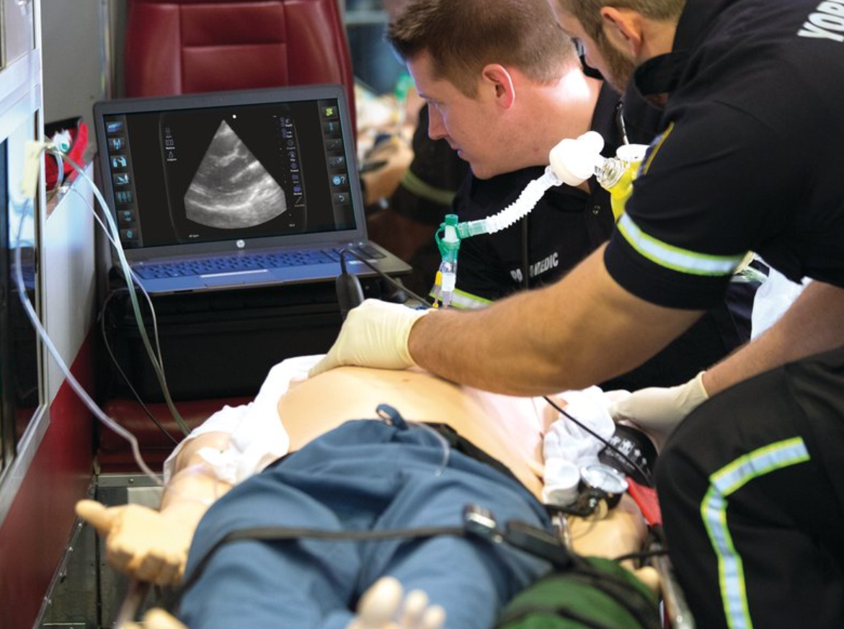

eFAST
Extended Focused Assessment using Sonography in Trauma

Slide 2
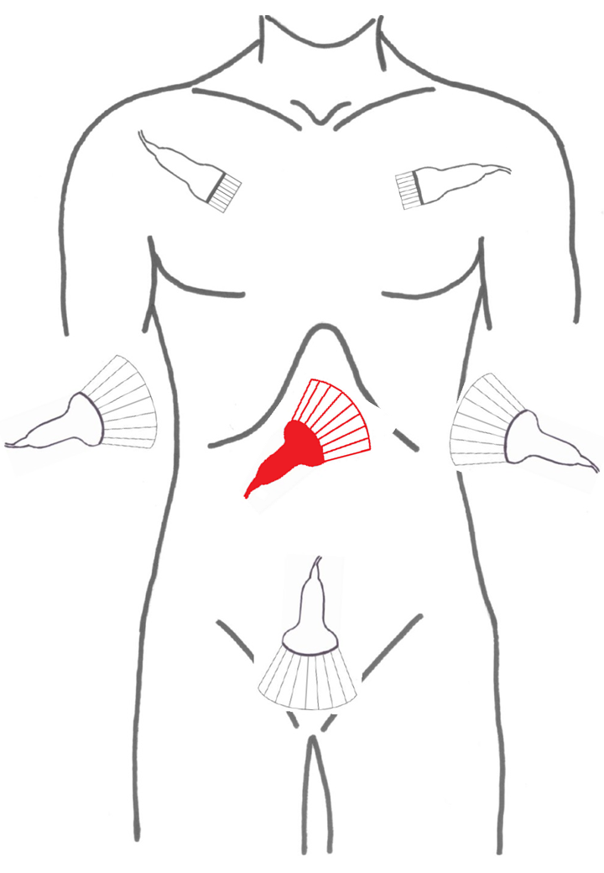
Zdroj: KARIM 1.LF UK a ÚVN

Slide 3
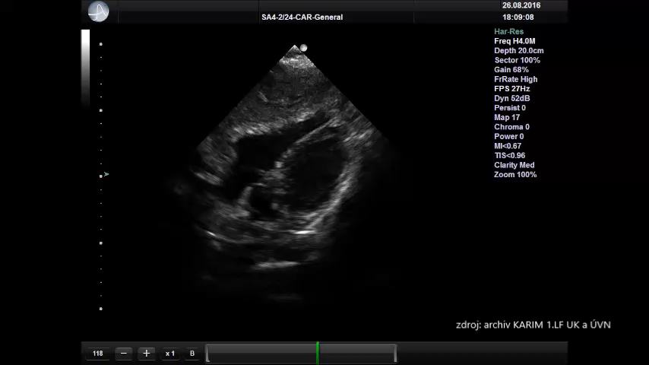
Pericardial view

Slide 4
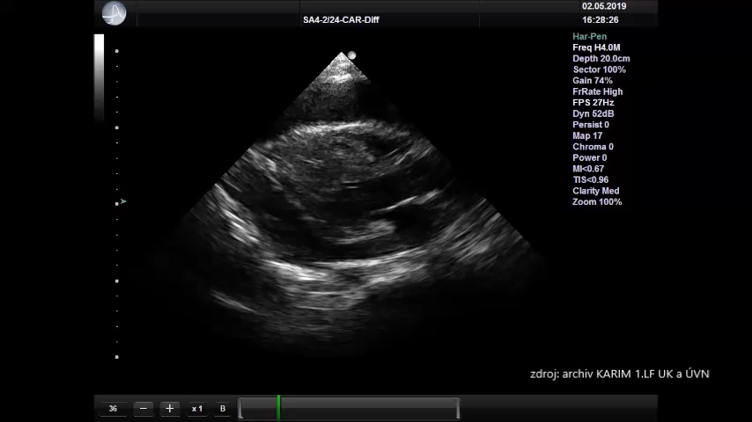
Pericarial view

Slide 5
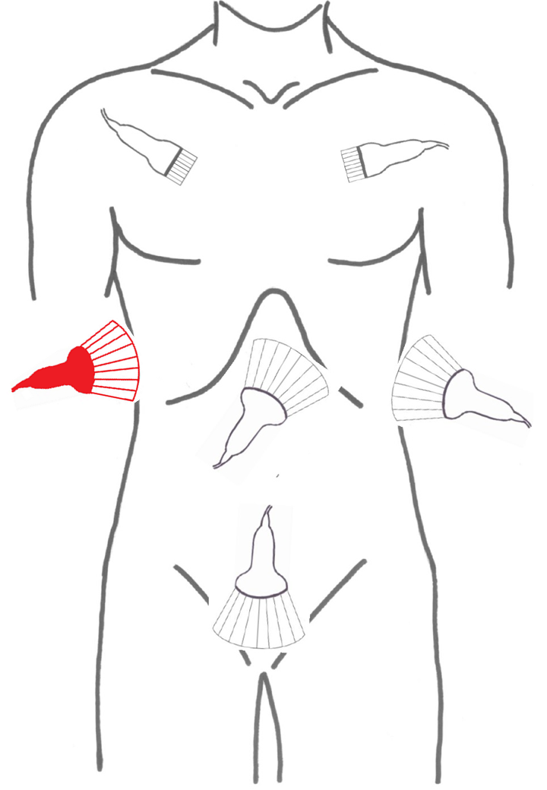
Zdroj: KARIM 1.LF UK a ÚVN

Slide 6
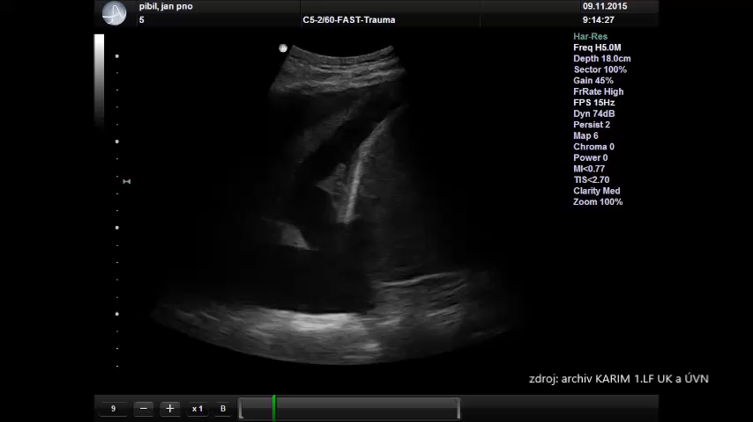
Perihepatic view-hemothorax

Slide 7
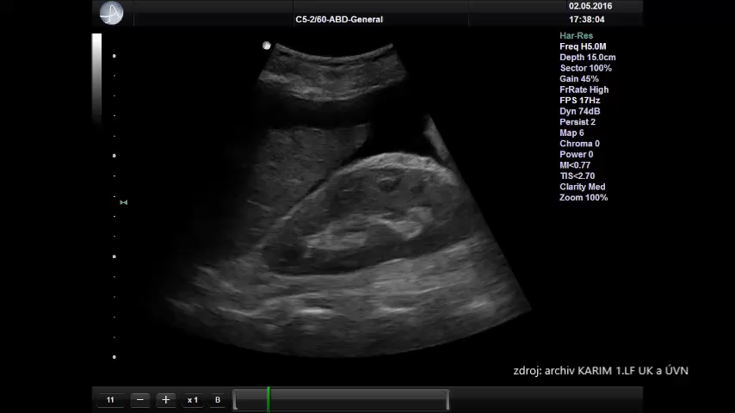
Perihepatic view -hemoperitoneum

Slide 8
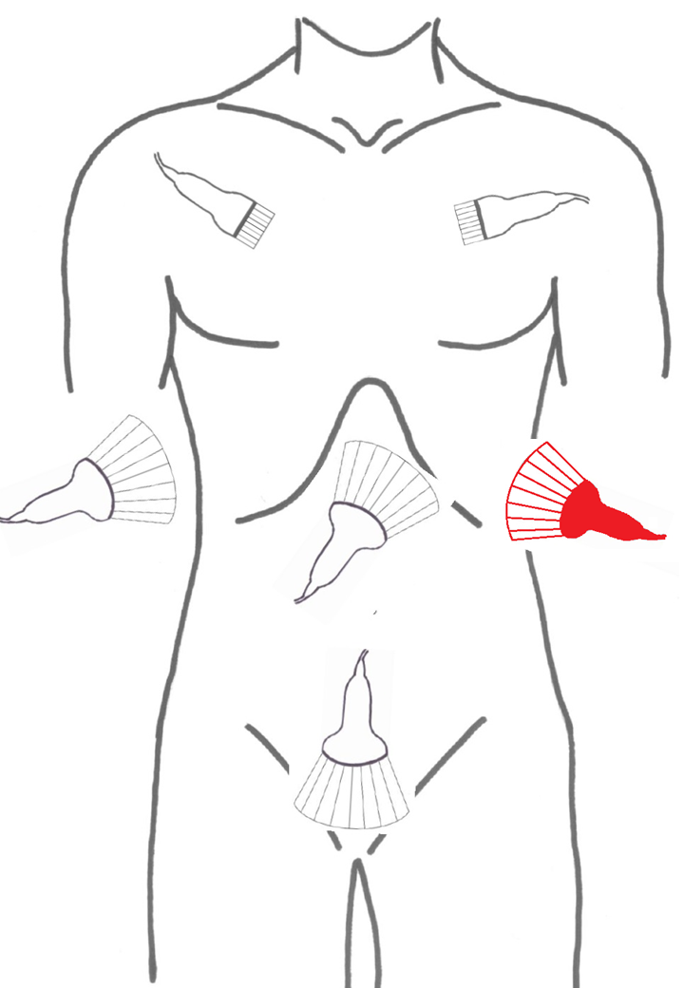
Zdroj: KARIM 1.LF UK a ÚVN

Slide 9
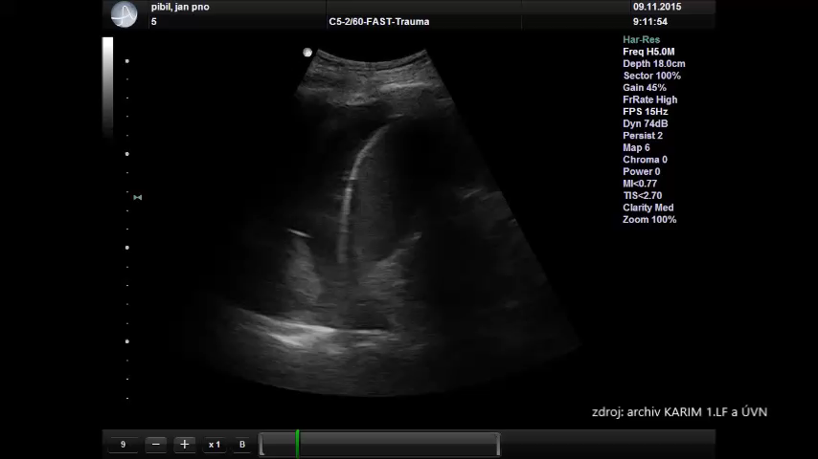
Perisplenic view-hemothorax

Slide 10
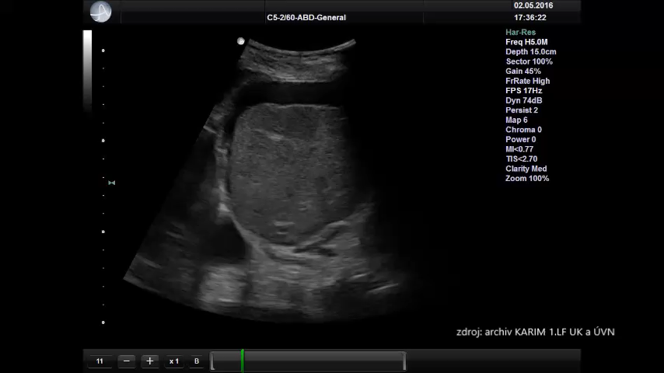
Perisplenic view-hemoperitoneum

Slide 11
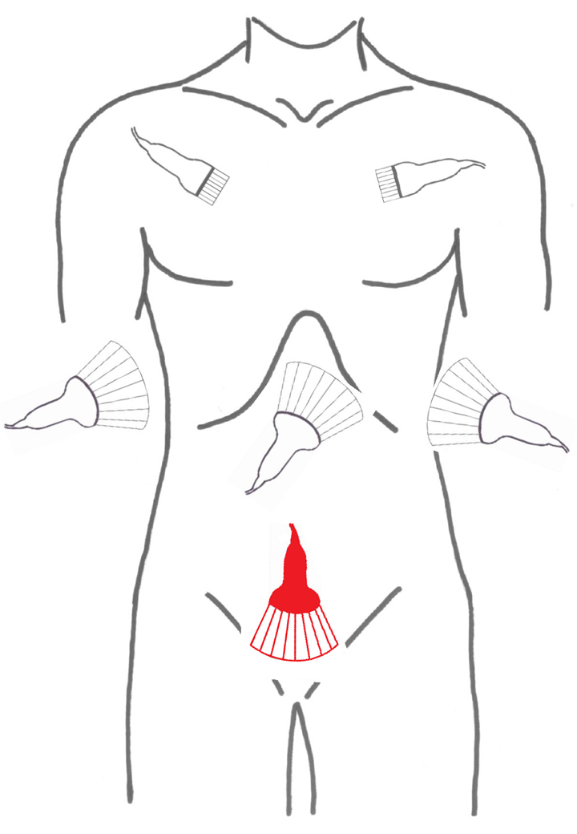
Zdroj: KARIM 1.LF UK a ÚVN

Slide 12
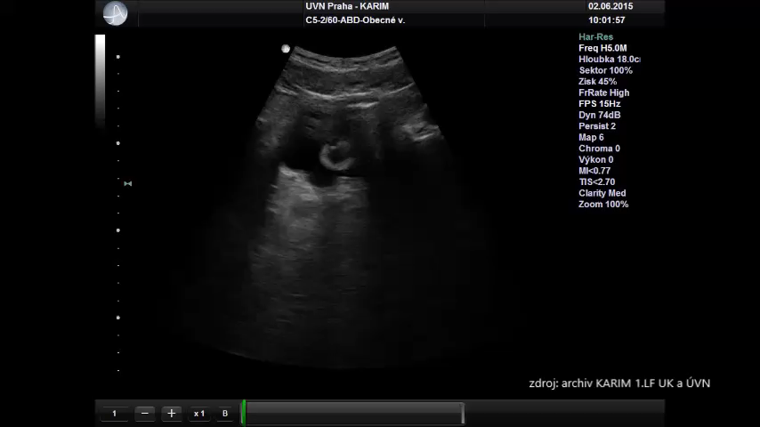
Pelvic view

Slide 13
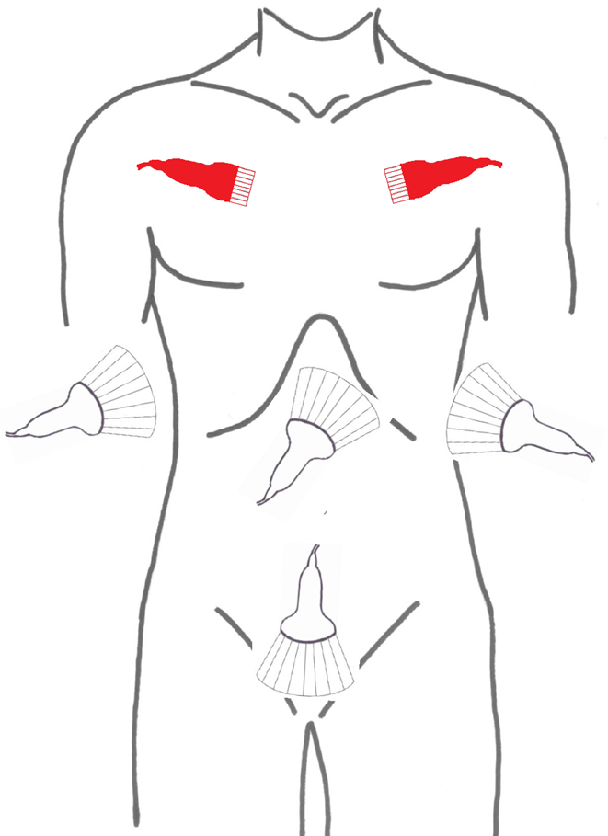
Zdroj: KARIM 1.LF UK a ÚVN

Slide 14
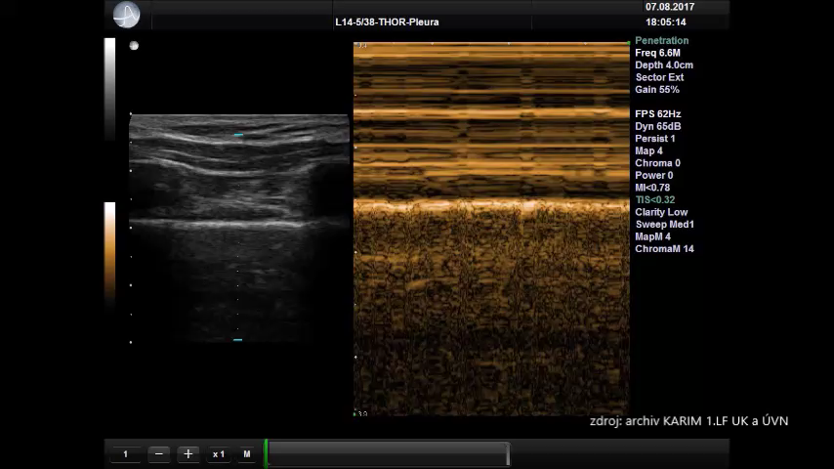
Lung Sliding

Slide 15
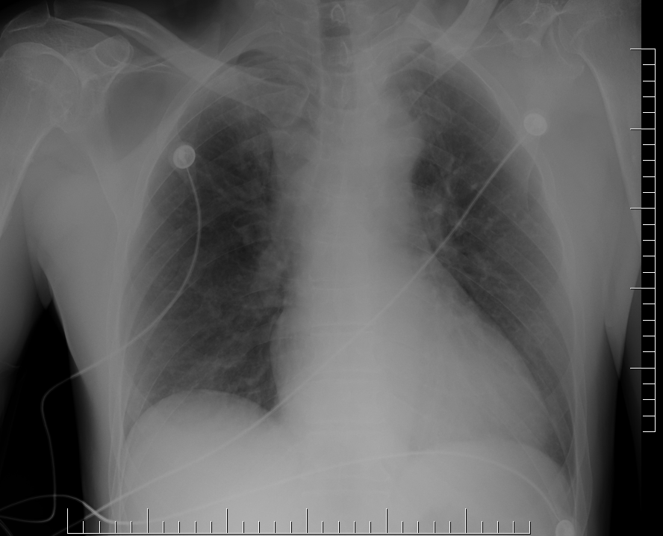
AP Chest X-Ray
Zdroj: KARIM 1.LF UK a ÚVN

Slide 16
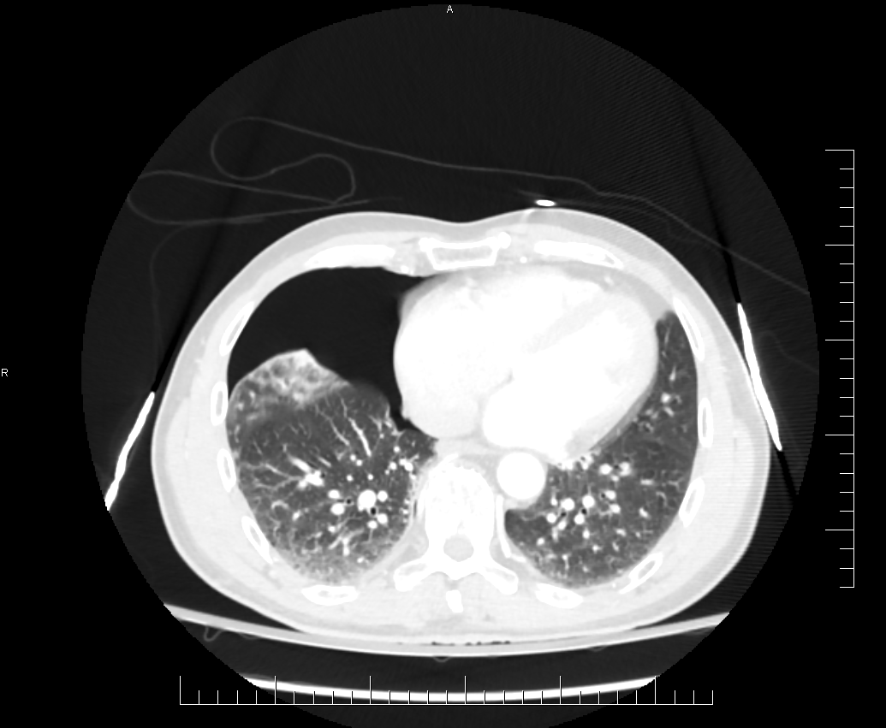
Chest CT
Zdroj: KARIM 1.LF UK a ÚVN

Slide 17
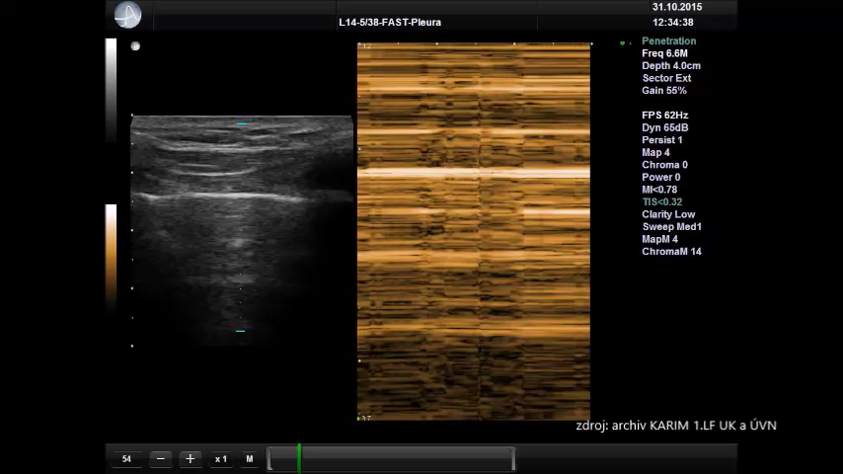
Barcode Sign

Slide 18
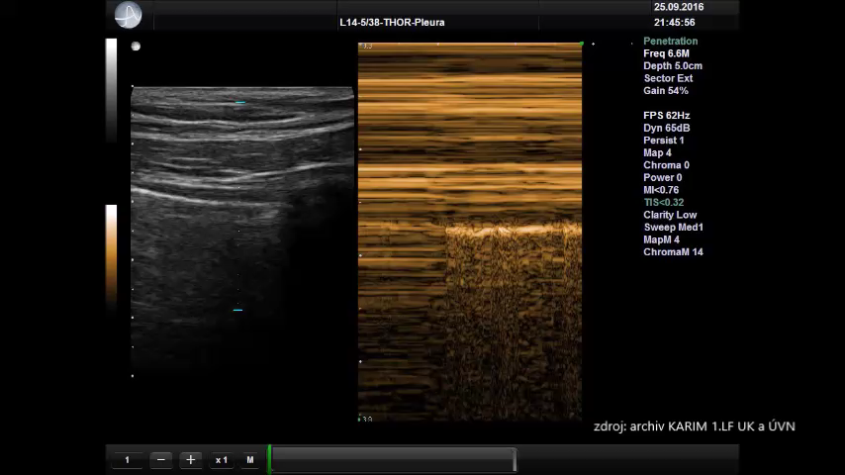
Lung Point

