Slide 1
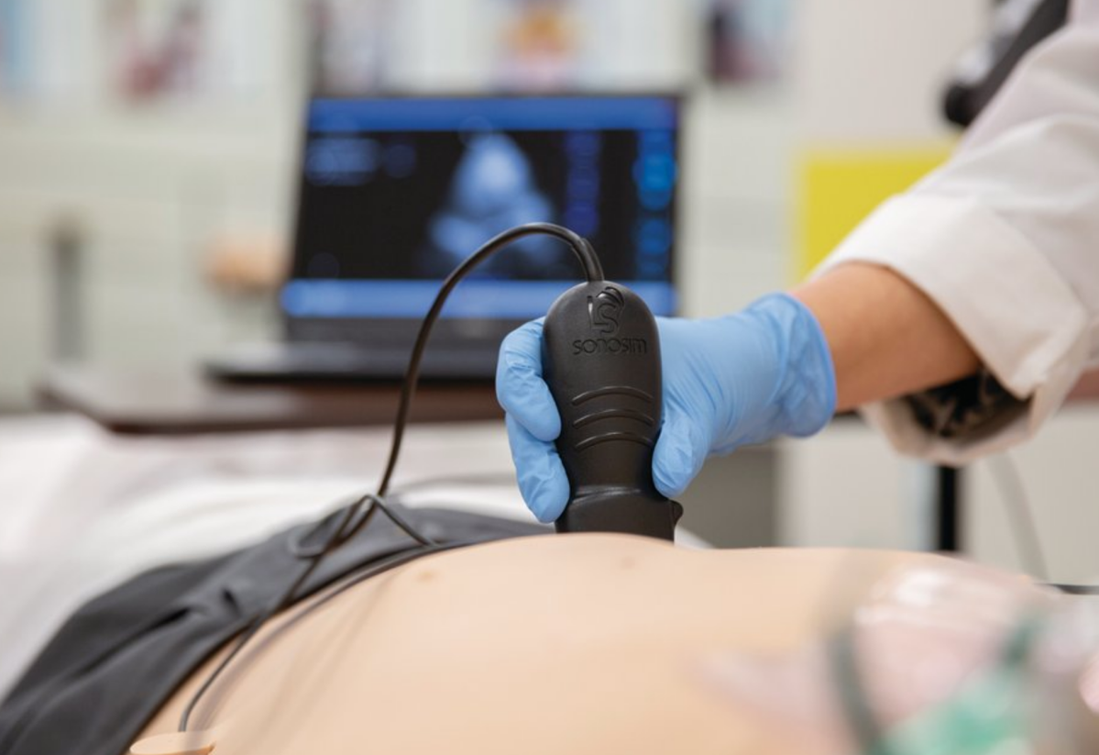

POCUS CA
Point Of Care UltraSound in Cardiac Arrest

Slide 2
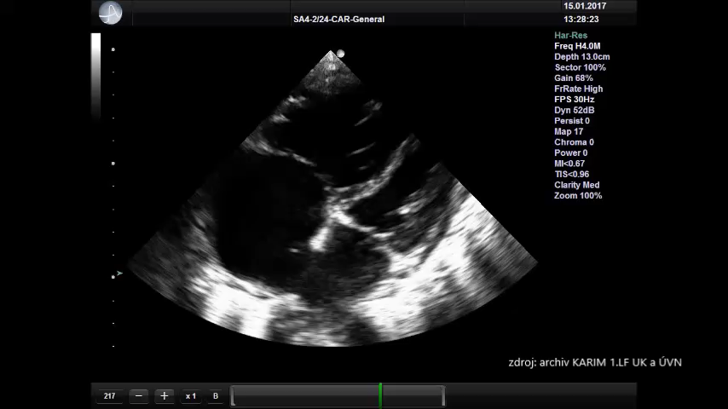
Pulmonary Emolism

Slide 3
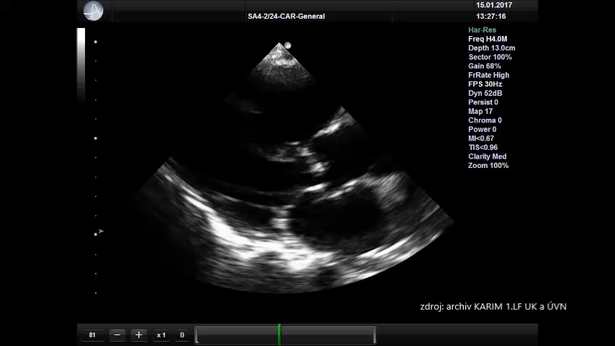
Pulmonary Embolism

Slide 4
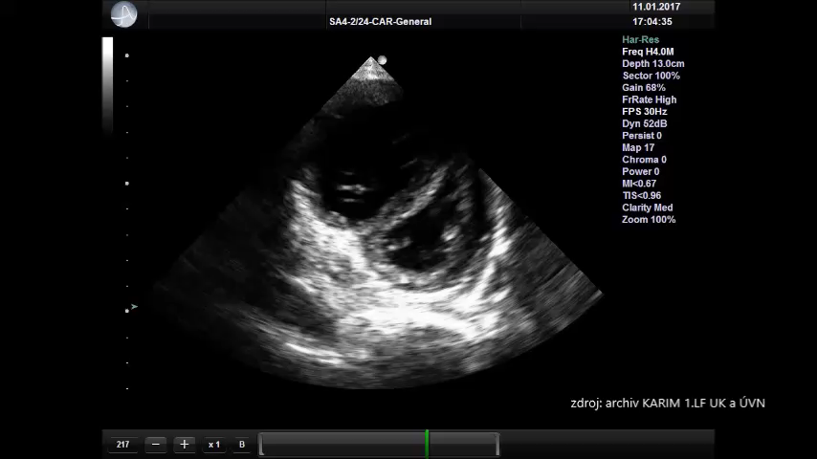
Pulmonary Embolism

Slide 5
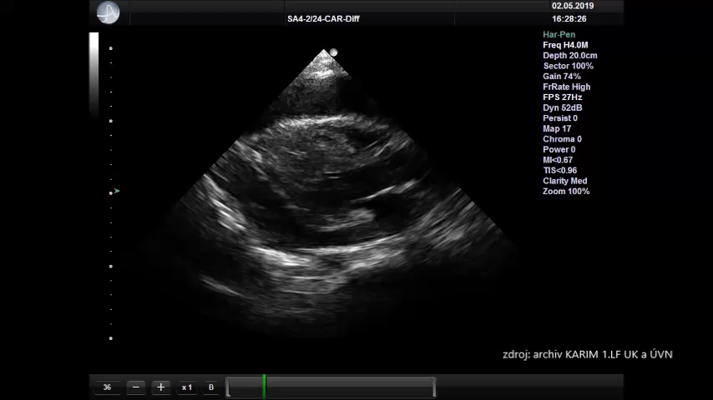
Pericardial Tamponade

Slide 6
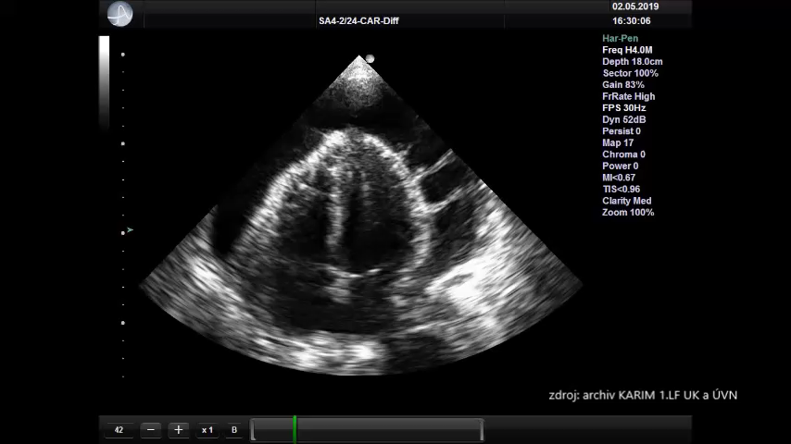
Pericardial Tamponade

Slide 7
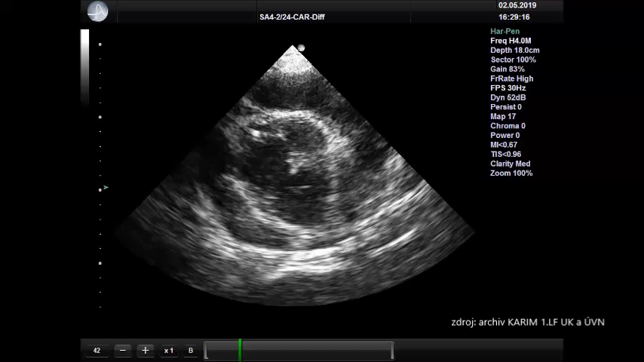
Pericardial Tamponade

Slide 8
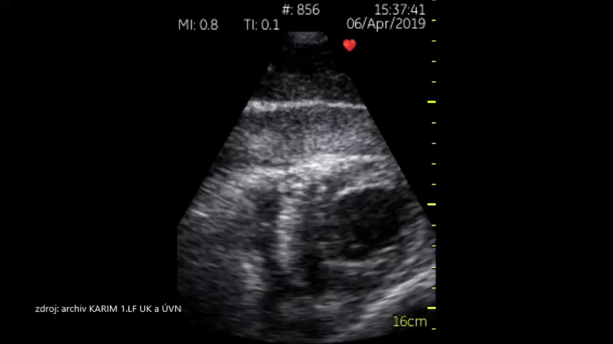
Pericardial Tamponade

Slide 9
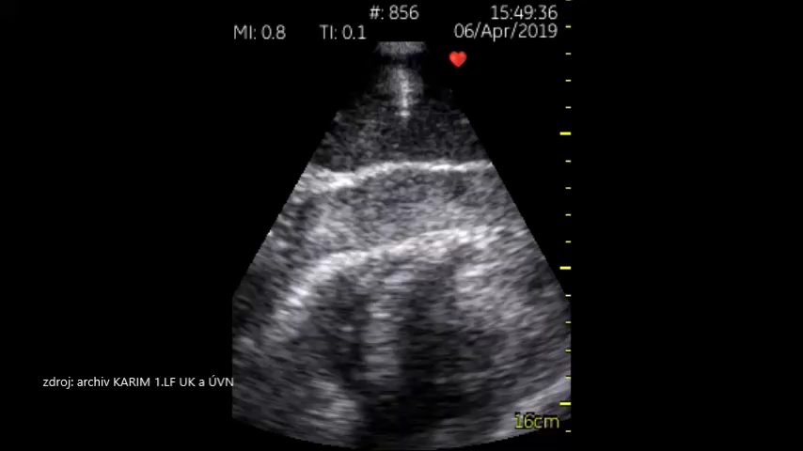
Pericardial Tamponade

Slide 10
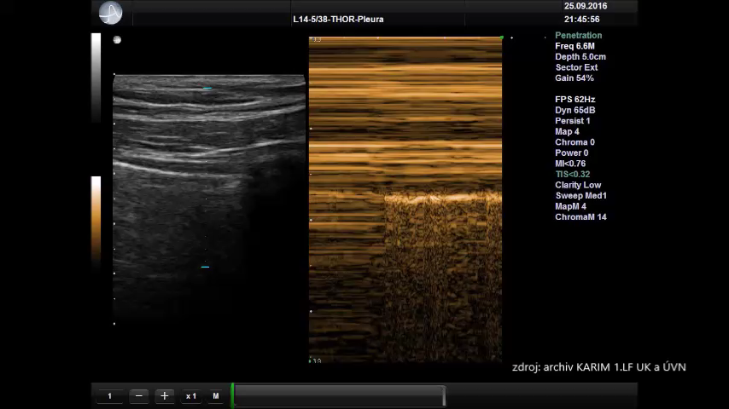
„Tension“ Pneumothorax

Slide 11
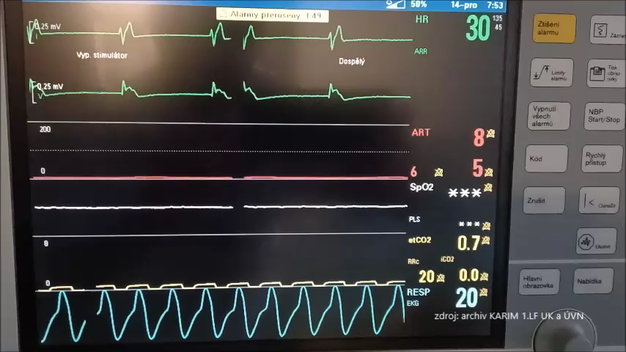
PEA

Slide 12
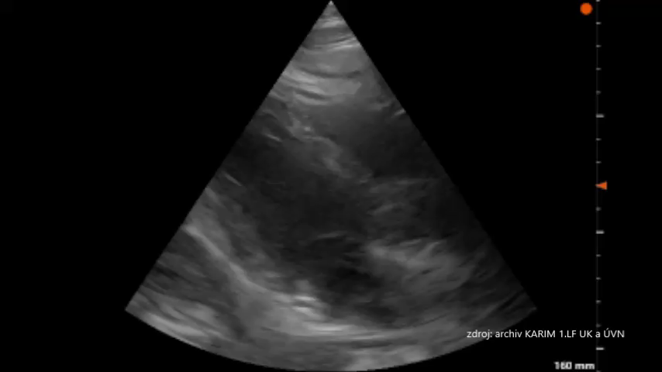
PEA?

Slide 13
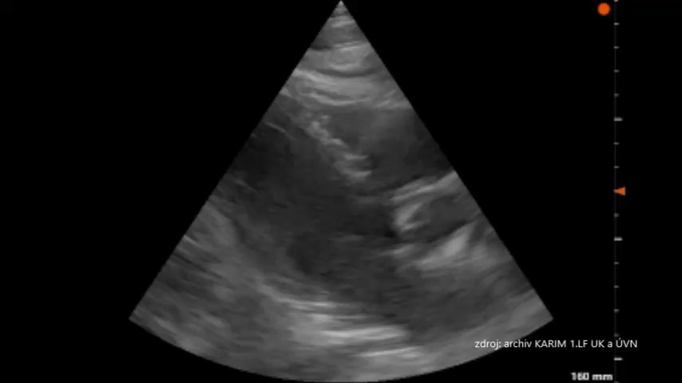
PEA

Slide 14
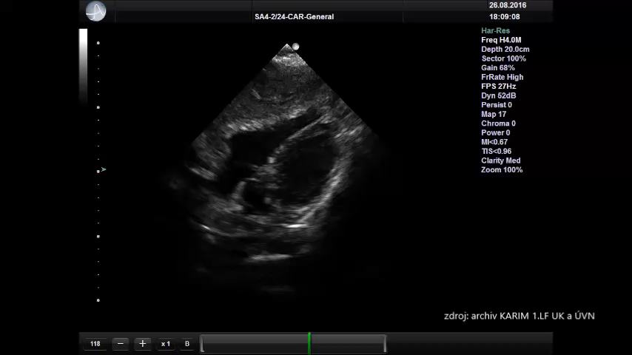
Severe Hypovolemia

Slide 15
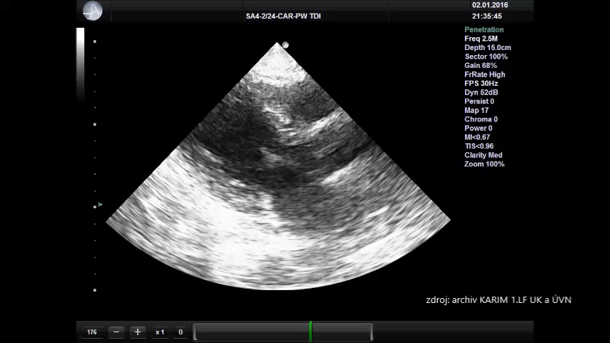
Severe Hypovolemia

Slide 16
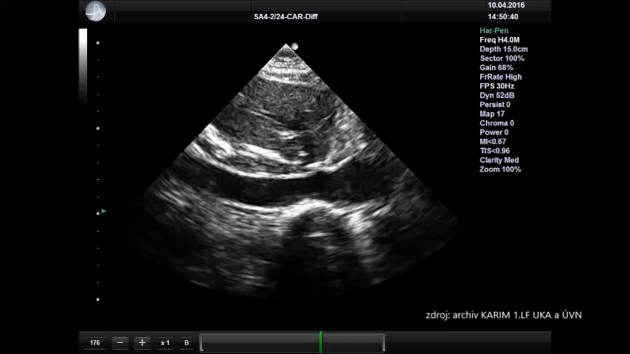
Severe Hypovolemia

