Slide 1
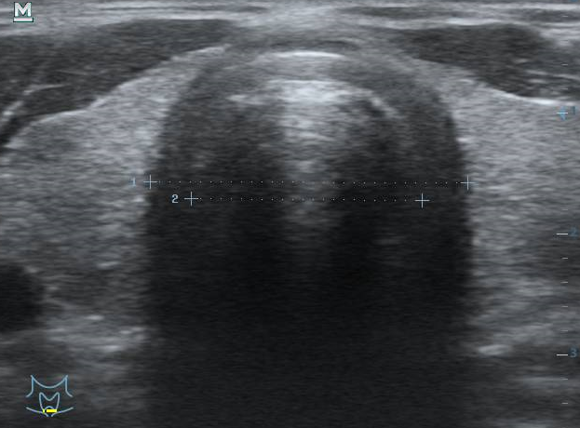

Ultrasound of cervical region of
RESPIRATORY
AIRWAYS

Slide 2
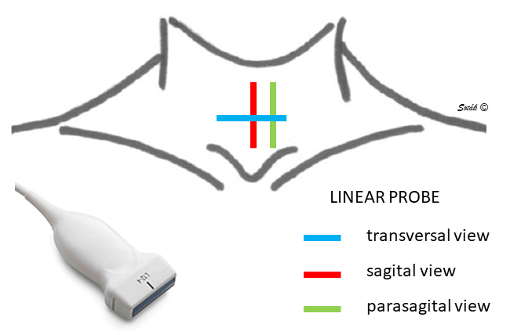

Slide 3
Indication
assessment of anatomical structures before tracheostomy
  feasibility of PDTS
  vascular structures below the site of the intended puncture
  thyroid gland isthmus
when deciding to use a percutaneous dilatation technique -> ultrasound navigation of the puncture
  level/height of puncture
  "centering" of the puncture

Slide 4
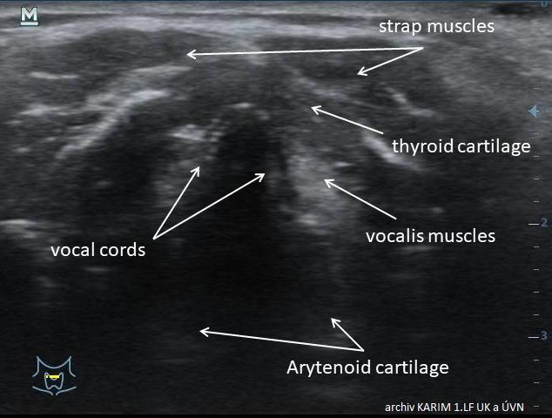

Slide 5
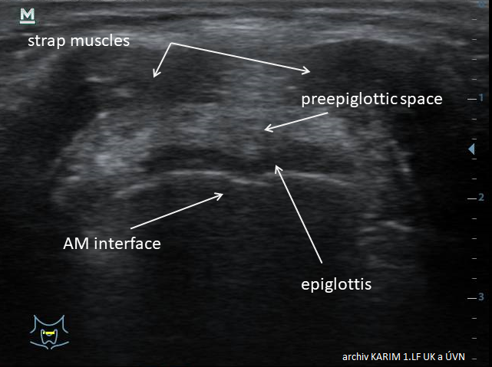

Slide 6
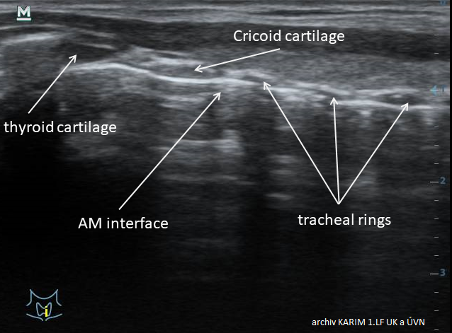

Slide 7
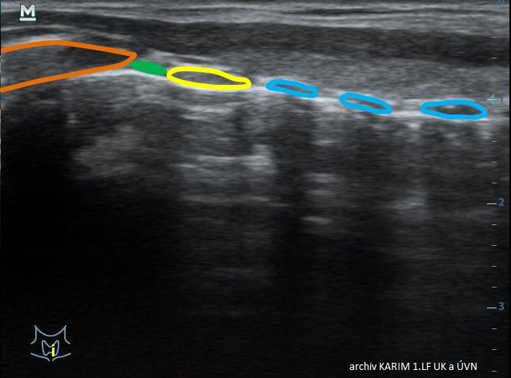

Slide 8
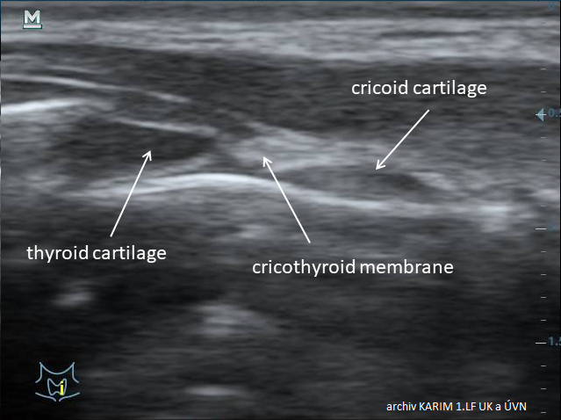

Slide 9
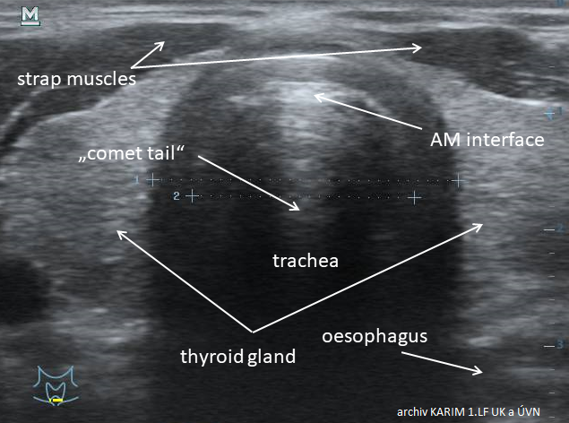

Slide 10
